Slide 1

COLD SPRINGS SEWER DISTRICT #1
December 2025

Slide 2
Cold Springs Sewer District #1
Background Information
In 2024 the Town of Lysander tasked CHA with performing a sewer study for the overall Cold Spring Peninsula located in the south ease quadrant of the Town.
The overall project area is currently served by septic systems with some newer developments having “dry sewers” already installed as part of the Town’s future planning to ultimately provide public sewers to the entire Cold Springs Peninsula.
Due to the projected high costs needed to provide public sewer service to the entire peninsula, the 2024 Sewer Study recommended that the project be completed in phases, starting with the pump station located closest to the Melvin Farms parcels, and the gravity sewers that would be directly tributary to that pump station.
The Lysander Town Board recently approved the Incentive Zoning Letter of Intent for the Melvin Farms project that necessitates that the Town Board move forward with the Cold Springs Sewer District #1 at this time.
This stage of sewer expansion within the Peninsula is also beneficial because it would connect existing dry sewers to the system and provide public sewer to Palmer Elementary School, whose existing septic system is nearing the end of its anticipated service life.

Slide 3
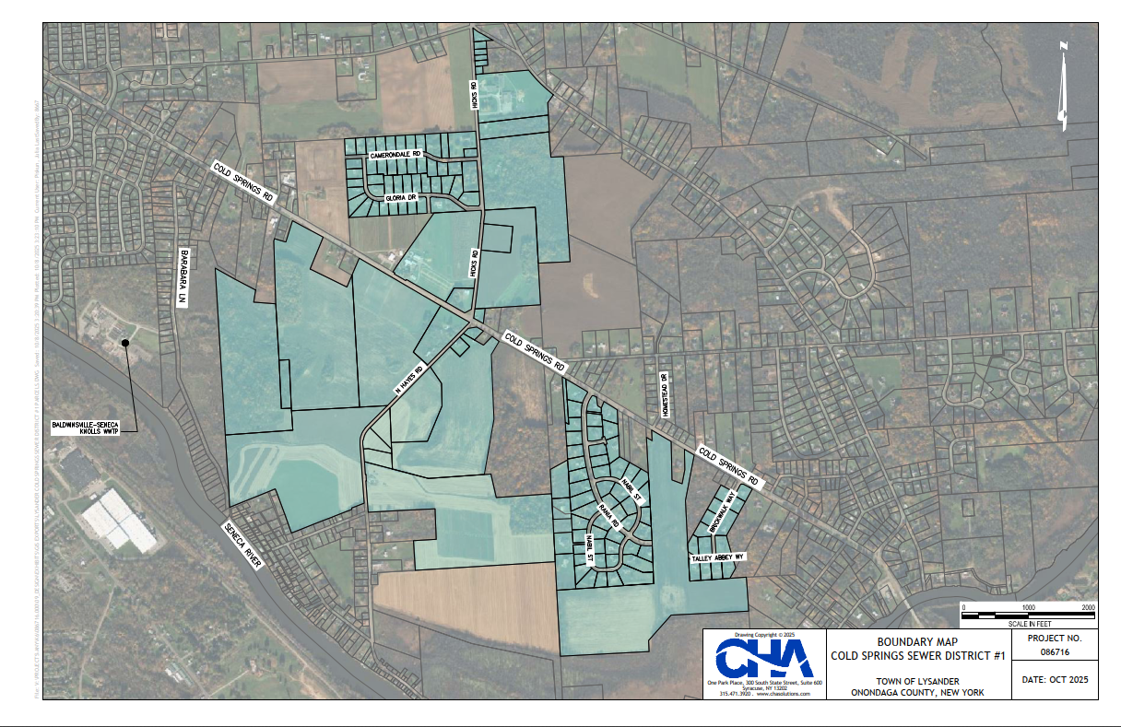
Cold Springs Sewer District #1
Boundary Map

Slide 4
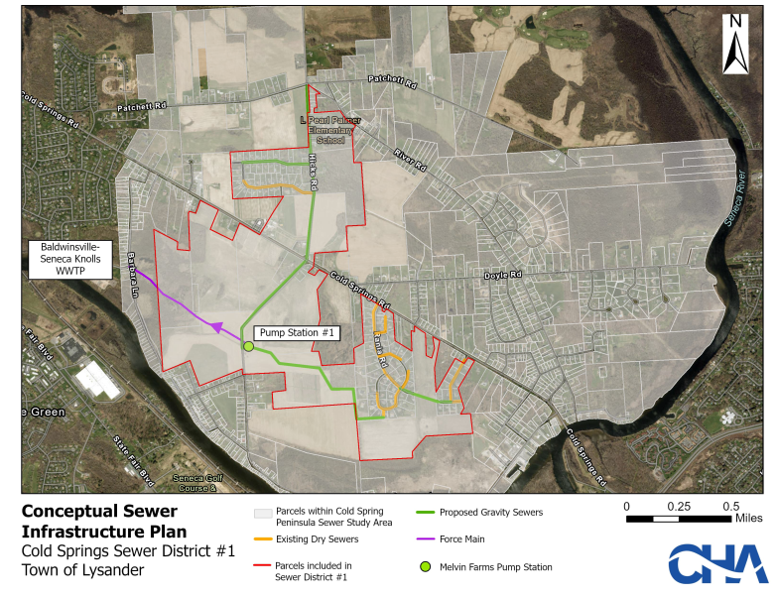
Sewer Infrastructure Plan

Slide 5
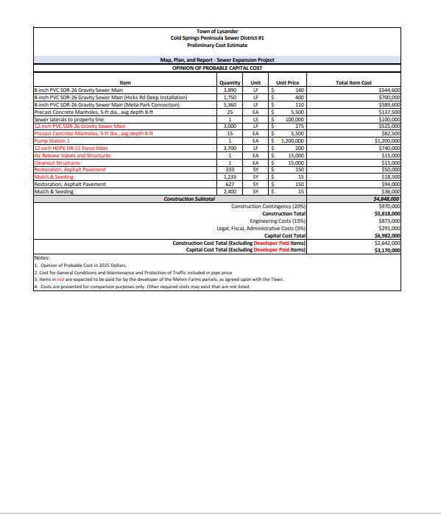
Cold Springs Sewer District #1
Preliminary Cost Estimate

Slide 6
Cold Springs Sewer District #1
Estimated First Year Resident Cost
• EDUs (Equivalent Dwelling Unit included (existing + planned): 681
Capital cost to Lysander: $3,170,000
Annual costs per EDU: $ 267 (Debt Service)
$ 453 (OCDWEP Fees 2025)
$ 720 (Total)
Connection costs to public sewer lateral will be the responsibility of each homeowner. Costs will vary depending on the length of pipe required to reach the sewer lateral.
Homeowners will be required to decommission the existing septic system on the property. Decommissioning includes pumping the existing septic tank and backfilling the septic tank with sand.
The Town will pursue additional grant opportunities for the project through the 2026 CFA which will may lower the anticipated cost per EDU
NYS Comptroller Annual Cost Threshold, 2025 Sewer: $663

Slide 7
Anticipated Project Schedule
Special District Map Plan and Report Draft approved by Town 11/6/2025
Town Board Special District formation by 12/04/2025
County and NYSDEC review of MPR completed by 1/15/2026
Contract drawing completed by 4/2/2026
County and NYSDEC review of contract drawing completed by 6/7/2026
Project bidding 7/18/2026
Project Award 8/20/2026
Project construction starting 10/6/2026
Project construction completed by 8/18/2027

Slide 8
Frequently Ask Questions
Q: Will roads be open cut for sewer Installation?
A: To the greatest extent possible road crossing will be directional drilled
Q: Will residents get to vote on the proposed sewer district formation?
A: The sewer district formation is subject to permissive referendum. If a petition is presented to the Town Board that includes at least 10% of the property owners that voted in the last governor election a requesting a vote one will be held.
Q: How much pipe will each property owner need to install to connect to the public sewer?
A: The public sewer lateral will terminate at the public road right-of-way. The distance required to connect will depend on how far off the road your home sits.
Q: Will residents get to vote on the proposed sewer district formation?
A: The sewer district formation is subject to permissive referendum. If a petition is presented to the Town Board that includes at least 10% of the property owners that voted in the last governor election a requesting a vote one will be held.

Slide 9
Frequently Ask Questions
Q: What happens if your existing septic system exits your home below the elevation of the public sewer lateral?
A: Public sewer laterals will be installed as deep as gravity will allow. Some homes may require the installation of a sanitary sewer grinder pump to connect to the public sewer.
Q: Will the town provide a list of approved contractors for homeowners to use?
A: The Town will not provide recommended contractors. Residents will be able to hire any contractor they wish that is a licensed plumber. There may be cost benefits available for neighbors hiring the same contractor and connecting at the same time.
Q: How much will it cost to decommission the existing septic system?
A: Septic system decommissioning cost are not expected to exceed $2,000.
Q: Will homeowners be billed by both the Town and the County if they do not connect to the public sewer?
A: Homeowners will only be responsible to pay the annual debt service until they connect to the public sewer.

Slide 10
Frequently Ask Questions
Q: What happens if Melvin Farms project does not pay their tax bill?
A: Onondaga County will reimburse the Town for any unpaid tax bills.
Q: When will homeowners receive their first sewer district tax bill?
A: The first sewer district tax bill would be included in the 2028 Town and County tax bill.
Q: If more homes are added to the district will our tax bill be lowered.
A: As more homes are added to the district on undeveloped parcels the debt service payment will be lowered.

